Slide 1
SQL Basics & Joins - Detailed Lecture
Week 9

Slide 2
Database
A database is an organized collection of data that allows users to store, retrieve, and manage information efficiently. Databases can be structured (like relational databases) or unstructured (like NoSQL databases). They serve various purposes, from tracking business transactions to storing user data for applications.
A relational database is a type of structured database that organizes data into tables (relations) with predefined columns and rows. It uses relationships between tables to efficiently link and retrieve data. Relational databases follow the principles of Structured Query Language (SQL) for querying and manipulating data.

Slide 3
Relational databases
Key characteristics of relational databases:
Tables: Store data in structured rows and columns.
Keys: Primary keys uniquely identify each row, while foreign keys establish relationships between tables.
Normalization: Reduces redundancy and ensures data integrity by structuring information across multiple tables.
SQL Usage: Queries like SELECT, JOIN, GROUP BY, and ORDER BY help retrieve meaningful insights.
Notes:
Normalization is a process in relational databases that organizes data efficiently to minimize redundancy and improve integrity. It ensures that data is stored across multiple related tables rather than being duplicated within a single large table.

Slide 4
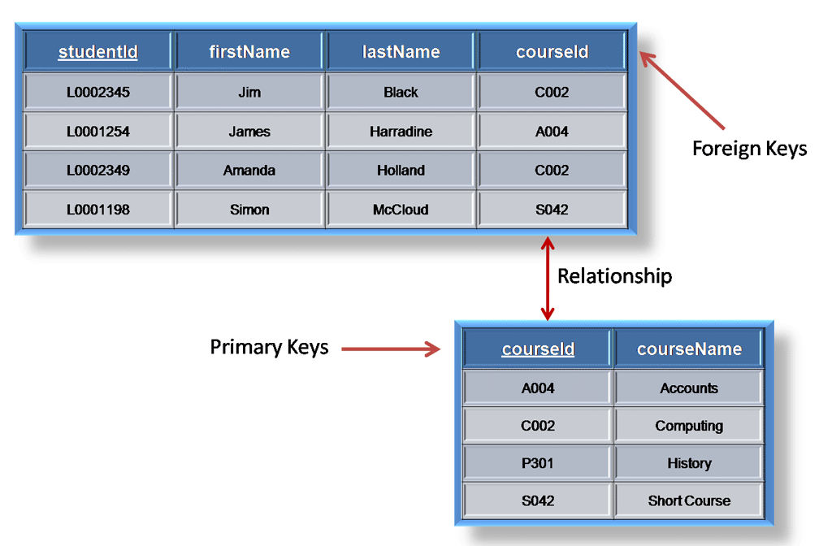
Primary

Slide 5
Normalization
The First Normal Form – 1NF
For a table to be in the first normal form, it must meet the following criteria:
a single cell must not hold more than one value (atomicity)
there must be a primary key for identification
no duplicated rows or columns
each column must have only one value for each row in the table

Slide 6
The Second Normal Form – 2NF
The 1NF only eliminates repeating groups, not redundancy. That’s why there is 2NF.
A table is said to be in 2NF if it meets the following criteria:
it’s already in 1NF
has no partial dependency. That is, all non-key attributes are fully dependent on a primary key.
The Third Normal Form – 3NF
When a table is in 2NF, it eliminates repeating groups and redundancy, but it does not eliminate transitive partial dependency.
This means a non-prime attribute (an attribute that is not part of the candidate’s key) is dependent on another non-prime attribute. This is what the third normal form (3NF) eliminates.
So, for a table to be in 3NF, it must:
be in 2NF
have no transitive partial dependency.

Slide 7
Student ID | Name | Subjects
1 | Alice | Physics, Math
2 | Bob | Chemistry, Biology
Student ID | Name | Subject
1 | Alice | Physics
1 | Alice | Math
2 | Bob | Chemistry
2 | Bob | Biology

Slide 8
2NF
Student_ID | Course_ID | Student_Name | Course_Name
1 | CS101 | Alice | Algorithms
1 | CS102 | Alice | Databases
2 | CS101 | Bob | Algorithms
Student_ID | Student_Name
1 | Alice
2 | Bob
Course_ID | Course_Name
CS101 | Algorithms
CS102 | Databases
Student_ID | Course_ID
1 | CS101
1 | CS102
2 | CS101

Slide 9
Student_ID | Student_Name | Department_ID | Department_Name
1 | Alice | D01 | Computer Science
2 | Bob | D02 | Mathematics
Student_ID | Student_Name | Department_ID
1 | Alice | D01
2 | Bob | D02
Department_ID | Department_Name
D01 | Computer Science
D02 | Mathematics

Slide 10
What is SQL?
SQL stands for Structured Query Language.
It is used for storing, manipulating, and retrieving data in relational databases.
SQL is a standard language supported by most RDBMS such as MySQL, SQL Server, and SQLite.

Slide 11
Applications of SQL
Data analysis and reporting
Data warehousing
Backend for web and mobile apps
Data integration in Big Data systems

Slide 12
RDBMS Overview
Relational Database Management Systems store data in tables.
Each table consists of rows and columns.
Tables can be linked using relationships.

Slide 13
Basic SQL Syntax
SQL statements are case-insensitive but typically written in uppercase.
Statements end with a semicolon ';'.
Keywords: SELECT, FROM, WHERE, GROUP BY, ORDER BY, JOIN, etc.

Slide 14
SELECT Statement - Basic
SELECT is used to fetch data from a database.
Syntax: SELECT column1, column2 FROM table_name;
Use '*' to select all columns: SELECT * FROM table_name;

Slide 15
SELECT Statement - Practice
Given a table 'students':
SELECT name, age FROM students;
SELECT * FROM students WHERE age > 18;

Slide 16
WHERE Clause - Basics
Used to filter records based on specific conditions.
Operators: =, <>, >, <, >=, <=, BETWEEN, LIKE, IN
Example: SELECT * FROM employees WHERE department = 'Sales';

Slide 17
WHERE Clause - Logical Operators
AND: Combines conditions that must both be true.
OR: Either condition can be true.
NOT: Negates a condition.
Example: SELECT * FROM employees WHERE age > 30 AND department = 'HR';

Slide 18
WHERE with BETWEEN, LIKE, IN
BETWEEN: SELECT * FROM employees WHERE age BETWEEN 25 AND 35;
LIKE: SELECT * FROM employees WHERE name LIKE 'A%’;
% means any number of characters (including zero).
id | Name | Department | Salary
1 | Alice | HR | 60000
2 | Andrew | IT | 75000
3 | Amanda | Sales | 52000

Slide 19
IN
SELECT * FROM employees WHERE department IN ('HR', 'Sales');
IN is a cleaner alternative to multiple OR conditions, Equivalent to:
department = 'HR' OR department = 'Sales’
id | name | department | salary
1 | Alice | HR | 60000
3 | Amanda | Sales | 52000
5 | Brian | HR | 58000

Slide 20
GROUP BY - Basics
GROUP BY groups rows that have the same values in specified columns.
Often used with aggregation functions: COUNT, SUM, AVG, MAX, MIN
Example: SELECT department, COUNT(*) FROM employees GROUP BY department;

Slide 21
GROUP BY with COUNT Example
SELECT department, COUNT(*) FROM employees GROUP BY department;
This query counts how many employees are in each department.
Example Output:
HR → 3 employees
Sales → 5 employees
IT → 4 employees
Useful for reports and summaries where aggregated data is needed.

Slide 22
GROUP BY - Practice
SELECT age, COUNT(*) FROM students GROUP BY age;
SELECT department, AVG(salary) FROM employees GROUP BY department;

Slide 23
ORDER BY - Basics
ORDER BY sorts the results returned by the query.
Default order is ascending (ASC), use DESC for descending.
Example: SELECT name, age FROM employees ORDER BY age DESC;

Slide 24
ORDER BY - Multiple Columns
ORDER BY can sort by multiple columns.
Example: SELECT name, department FROM employees ORDER BY department, name ASC;

Slide 25
Combining SELECT, WHERE, GROUP BY, ORDER BY
Example:
SELECT department, COUNT(*) FROM employees WHERE salary > 50000 GROUP BY department ORDER BY COUNT(*) DESC;

Slide 26
Common Errors and Tips
Check column names and table names for typos.
Use semicolons to terminate statements.
Test queries step-by-step.

Slide 27
Introduction to Joins
Joins are used to retrieve data from multiple related tables.
Types: INNER JOIN, LEFT JOIN, RIGHT JOIN, FULL JOIN
Each join type defines how unmatched rows are handled.

Slide 28
INNER JOIN - Basics
Returns rows with matching values in both tables.
Syntax: SELECT columns FROM table1 INNER JOIN table2 ON table1.column = table2.column;

Slide 29
INNER JOIN - Example
SELECT employees.name, departments.name FROM employees INNER JOIN departments ON employees.dept_id = departments.id;

Slide 30
LEFT JOIN - Basics
Returns all records from the left table and matched records from the right table.
Unmatched rows from the right table return NULL.

Slide 31
LEFT JOIN - Example
SELECT employees.name, departments.name FROM employees LEFT JOIN departments ON employees.dept_id = departments.id;

Slide 32
RIGHT JOIN - Basics
Returns all records from the right table and matched records from the left table.
Unmatched rows from the left table return NULL.

Slide 33
FULL JOIN - Basics
Combines results of both LEFT and RIGHT JOIN.
Returns all records when there is a match in either left or right table.

Slide 34
FULL JOIN - Example
SELECT e.name, d.name FROM employees e FULL JOIN departments d ON e.dept_id = d.id;

Slide 35
CROSS JOIN - Basics
Returns Cartesian product of two tables.
Every row of the first table is joined to every row of the second table.

Slide 36
CROSS JOIN - Example
SELECT * FROM employees CROSS JOIN departments;

Slide 37
Using Aliases in Joins
Shorten query and improve readability.
Example: SELECT e.name, d.name FROM employees AS e JOIN departments AS d ON e.dept_id = d.id;

Slide 38
Nesting Joins
Multiple joins can be chained.
Example: SELECT e.name, d.name, l.city FROM employees e JOIN departments d ON e.dept_id = d.id JOIN locations l ON d.loc_id = l.id;

Slide 39
Join Practice - 1
Use INNER JOIN to fetch employee names with their department names.

Slide 40
Join Practice - 1
Use INNER JOIN to fetch employee names with their department names.
SELECT e.name AS employee_name, d.name AS department_name FROM employees e
INNER JOIN departments d ON e.dept_id = d.id;

Slide 41
Join Practice - 2
Use LEFT JOIN to list all employees and their departments, even if the department is missing.

Slide 42
Join Practice - 3
Combine JOIN with WHERE and ORDER BY.
Example: SELECT e.name, d.name FROM employees e JOIN departments d ON e.dept_id = d.id WHERE d.name = 'Sales' ORDER BY e.name;

Slide 43
Join class Questions
1. What's the result of an INNER JOIN with no matching keys?
2. How does a LEFT JOIN differ from a FULL JOIN?
3. Write a query that shows departments without employees.

